Slide 1
Where to find best practices? Lessons from the Field
Taylor L. Crisman, BS
Meg Normand, BA
K. Malulani Castro, BA
Margaret Jenkins
Ignacio D. Acevedo-Polakovich, PhD

Slide 2
Overview

Slide 3
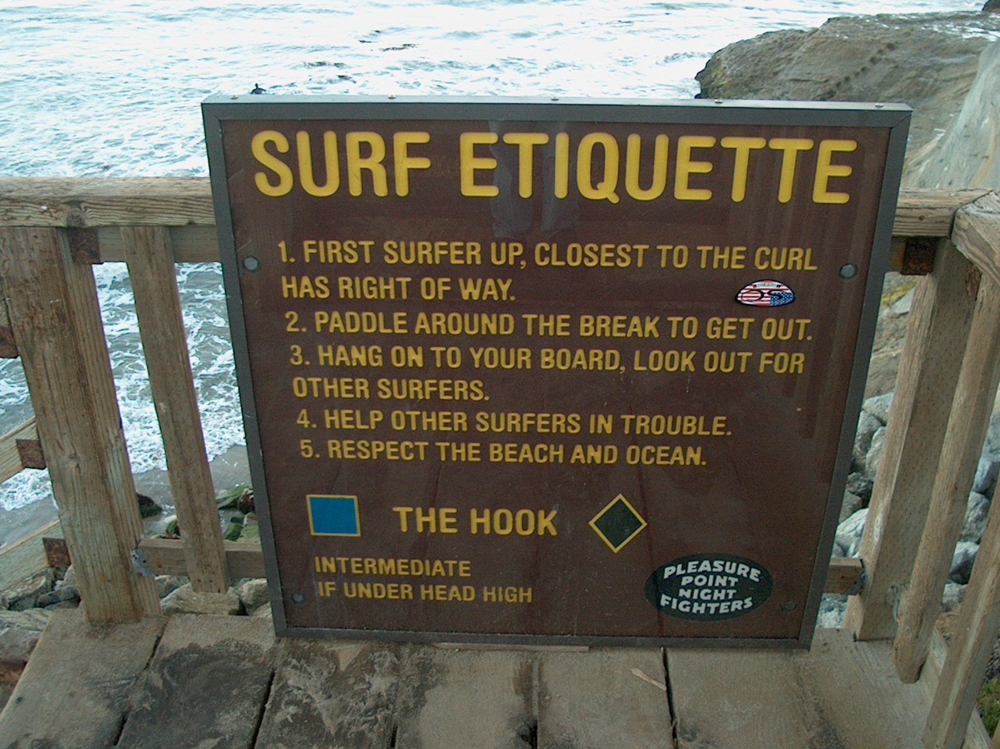
What are “Best Practices”
“A set of procedures that are accepted or prescribed as being correct or most effective.”

Slide 4
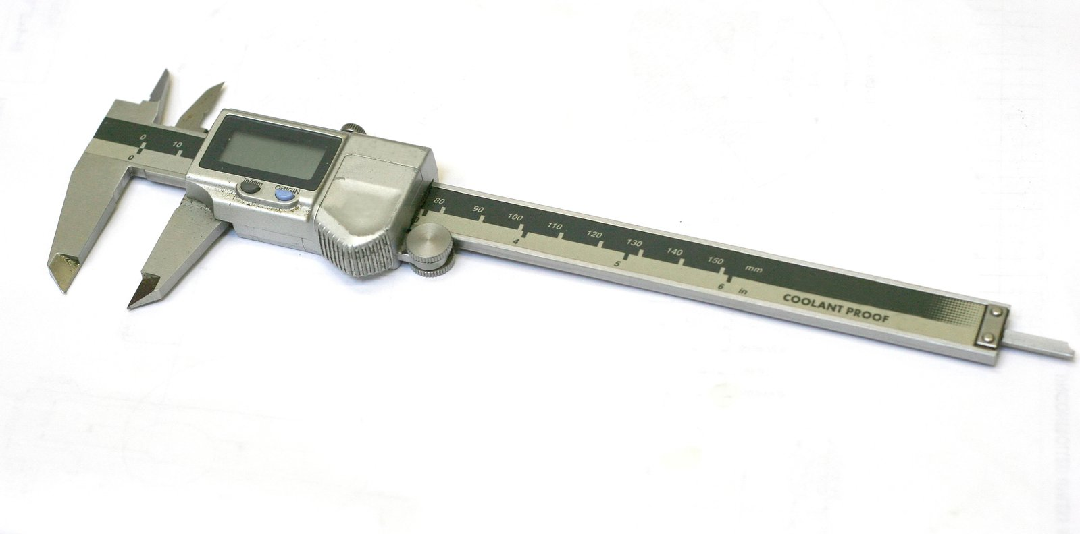
The Value of Best Practices for Evaluation
In evaluation, best practices can:
Provide a metric for the entity being evaluated.
Ensure the relevance of evaluation for practice.
Support the trustworthiness and/or face validity of designs, results and recommendations.

Slide 5
Limitations of Best Practices
The uncritical acceptance of best practices can lead to their reification, and to erred conclusions and recommendations
Established by whom?
On what basis?
Why should evaluation clients care?

Slide 6
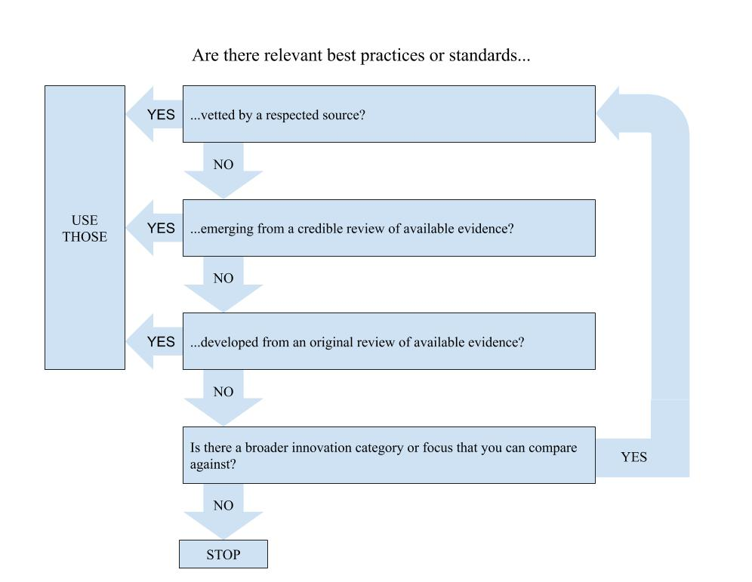
Great! Where do I find best practices…

Slide 7
… and how do I use them?
When designing and evaluating (e.g., by making comparison, tracking adherence, using dose-response [or other mediational] designs).
When reporting and making conclusions (e.g., next steps, etc.)

Slide 8
Goal of this symposium:
Share practical lessons in identifying and using best practices in the context of program evaluation.

Slide 9
Overview
Best Practices in the Context of the Rapid Evaluation and Dissemination of Innovations (REDI)
Integrated student support strategy
College enrollment & success program
Indigenous and non-Indigenous Networks
Conclusions & Implications

Slide 10
REDI Phase
Current Implementation Assessment (Evaluability)
Review Practice Materials
to Document:
Required Resources
Required Networks
Logic Model
Incorporation of Best-Practices
Available Implementation and Outcomes Evidence
Continuous Quality
Improvement
Develop and implement an evaluation strategy to examine:
Practice effects.
The mechanisms or components that drive effects.
Whether the practice can be improved.
Dissemination
Register the practice (if applicable)
Establish whether dissemination is desired.
Develop dissemination and implementation (D&I) processes.
Implement D&I
3-6 Months
6 Months +
6 Months +

Slide 11
Identifying best practices in implementing district-wide integrated student supports.
Taylor L. Crisman, BS
Ignacio D. Acevedo-Polakovich, PhD

Slide 12
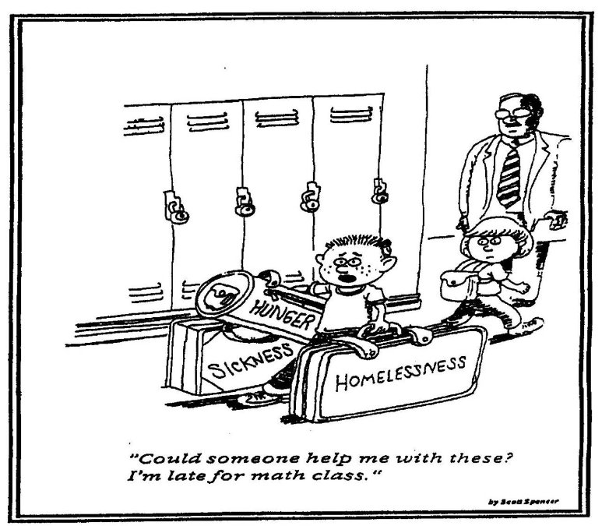
Community Schools
Transform schools into a neighborhood hub offering services and supports for children, families, and community members
Based on the assumption that students’
academic success is greatly impacted by
conditions in which they live (Heers et al., 2016)

Slide 13
REDI Phase 1: Implementation Assessment
Administrative documents & data
Site visits & semi-structured interviews
Existing research & evaluation
Regular meetings & contact with implementers
What defines this implementation of the Community Schools Approach?

Slide 14
Literature Review
Community school approaches have evolved over the last 100 years
Several different organizations support this work around the country
5,000+
Schools in the US
25,000+
Schools in the Europe

Slide 15
Best Practices: Components of Successful Community Schools
Integrated Student Support Components (Child Trends, 2014)
Assessment-driven service planning
Coordination of multi-sector supports
Integration of services into school settings
Creation & maintenance of community partnerships
Outcome monitoring based on routinized data collection
Community School Components (Heers et al., 2016)
Fostering parent involvement
Offering needed extracurricular activities

Slide 16
Best Practices: Components of Successful Community Schools
Community School Standards (Coalition for Community Schools, 2017)
Sustainability
Coordinating infrastructure
Collaborative leadership
Planning
Student-centered data
Continuous improvement
Powerful learning
Integrated health and social supports
Authentic family engagement
Authentic community engagement

Slide 17
Lessons Learned
Continually check for new standards for best practices
Be prepared to update practices as new standards are established

Slide 18
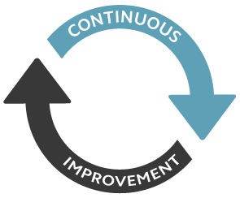
Implications and Final Thoughts
Occasionally review literature on best practices
REDI process allows for continuous improvement
Updating best practices to reflect new standards

Slide 19
Identifying best practices within a college enrollment and retention program for migrant farmworkers.
Meg Normand, BA
Ignacio D. Acevedo-Polakovich, PhD

Slide 20
Migrant Farmworkers
Persons who forgo a permanent residence in pursuit of agricultural labor.
There are more than 300,000 migrant students in the United States (US Department of Ed, 2017)

Slide 21
Educational Inequities Among Migrant Farmworkers
Only 28% of migrant farmworker children will complete high school (Kandel, 2008), compared to 90% of US school-age children.
Only a small, not well-documented, percentage of migrant farmworkers with a HS degree will enroll in college, compared to 41% for the overall US population. (National Center for Education Statistics, 2017)

Slide 22
College Assistance Migrant Program (CAMP)
Federal educational program for individuals with migrant or seasonal farm work backgrounds.
Each of 43 national sites must meet specific basic parameters, but then can innovate around these.
Our partners take a whole-person approach to educational engagement and retention.
Program assists students with academic, social, and financial support to enable them to complete their first year of college.

Slide 23
REDI Phase
Current Implementation Assessment (Evaluability)
Review Practice Materials
to Document:
Required Resources
Required Networks
Logic Model
Incorporation of Best-Practices
Available Implementation and Outcomes Evidence
Continuous Quality
Improvement
Develop and implement an evaluation strategy to examine:
Practice effects.
The mechanisms or components that drive effects.
Whether the practice can be improved.
Dissemination
Register the practice (if applicable)
Establish whether dissemination is desired.
Develop dissemination and implementation (D&I) processes.
Implement D&I
3-6 Months
6 Months +
6 Months +

Slide 24
Comparison to Best Practices
Domain | CAMP Component | Local CAMP Component?
Phase One
Recruitment | Assistance with official forms ^{1, 2} | Yes
Phase Two
Academic Preparation | University Orientation ^{1, 4} | Yes
 | Freshman Seminar ^{2, 4} | Yes
 | Assistance with college transition ^{1, 5} | Yes
 | Internal Academic Partnerships ⁵ | Yes
Academic Support | Skills assessment ¹ | Yes
 | Tutoring ^{1, 2, 4, 6} | Yes
 | Class Advising ^{4, 5, 6} | Yes
Financial Assistance | Tuition ^{1, 4, 6} | Yes
 | Scholarships ^{6, 7} | Yes
 | Housing ^{1, 4, 7} | Yes
 | Food ⁵ | Yes
Cultural Exposure | On-campus cultural celebration participation ³ | No
 | CAMP retreats ⁴ | Yes
Professional Development | Resume preparation ⁴ | Yes
 | Career advising ^{3, 4, 6} | Yes
 | Required Community Service Hours ¹ | No
Personal Support | Sense of community ^{1, 2, 3, 4, 5, 6, 7} | Yes
 | CAMP drop-in center ^{3, 4, 5} | Yes
 | Healthcare service referrals ¹ | Yes
Phase Three
Internships | Internship Preparation ⁴ | Yes

Slide 25
Lessons Learned
Evaluation and improvement is high priority
For both organization and Department of Education
Barrier: No increased funding
Need for national set of standards
How will we do this without increased funding?

Slide 26
Implications
Allows us to move onto Continuous Quality Improvement (CQI) phase
Found that organization is providing most CAMP components described in the literature
Collaboration with another CAMP program
Compare CAMP programs
Goal: Identify CAMP components that provide positive outcomes

Slide 27
Practice-based research in boundary spaces: The relevance of REDI in initiatives to promote Indigenous and non-Indigenous networks.
K. Malulani Castro, BA
Kyle P. Whyte, PhD
Ignacio D. Acevedo-Polakovich, PhD

Slide 28
Overview
Evaluation context and objectives
Identification of Standards Metrics
Implementation of Standards Comparison
Lessons Learned
Evaluation Implications

Slide 29
Evaluation Context
A boundary organization that seeks to create opportunities for Indigenous and non-Indigenous networks to co-produce environmental science and policy.
Members participate in:
Annual workshops
An active listserv
Cross institutional collaborations
Over 100 representatives from Indigenous and non-Indigenous communities/institutions (e.g., federal agencies, tribal governments) have networked in just three years.

Slide 30
Evaluation Context
Boundary organizations seek to operate as credible, salient, and legitimate collectives across diverse research and practice generational communities (Meadow et al., 2015).
Boundary organizations work through the implementation of practices focused on mutual respect, participation from all groups involved, and the meaningful engagement of multiple opinions (Maldonado et al., 2016).
Example: National Association of County Agricultural Agents; implemented a boundary organization framework to improve researcher/farmer agricultural extension work.

Slide 31
Evaluation Goals
Onboard steering council and boundary organization members to the REDI evaluation framework.
Identify best-practices of assessment for scientist-stakeholder collaborations.
Implement evaluation practices that measure outputs needed by the organization’s funding partners.

Slide 32
Identification of Standards Metrics
Framework Standards | Funding Standards
Partnerships and Collaborations List and description of collaborations/collaborators | Partnerships and Collaborations List and description of collaborations/collaborators
Workshop Research Activities Attendance and feedback on learning impact | Workshop Research Activities Attendance and feedback on learning impact
Credibility Responses on collaborations credibility | Improve Understanding of Climate Variability Rate and impact of publications
Legitimacy Responses on collaborations legitimacy | Diversity Identification of identities represented
Saliency Responses on collaborations saliency | Inclusivity Identification of perceived access for identities

Slide 33
Lessons Learned
Evaluation Context
Institutional Partners’ Needs
Indigenous Frameworks
/Goals
Boundary Organization Theory
Non-Indigenous Frameworks
/Goals
Organization Needs

Slide 34
Implications
Indigenous
Standards Metrics
Dialogue
Non-Indigenous

Slide 35
Implications
Funders
Organization
Diversity
Workshop Activity
Workshop Activity
Collaborations
Collaborations
Participant Check

Slide 36
Implications
Indigenous Groups
Organization
Separate Evaluations
Institutional Partners
Non-Indigenous Groups

Slide 37
Discussion
Ignacio D. Acevedo-Polakovich, PhD

Slide 38
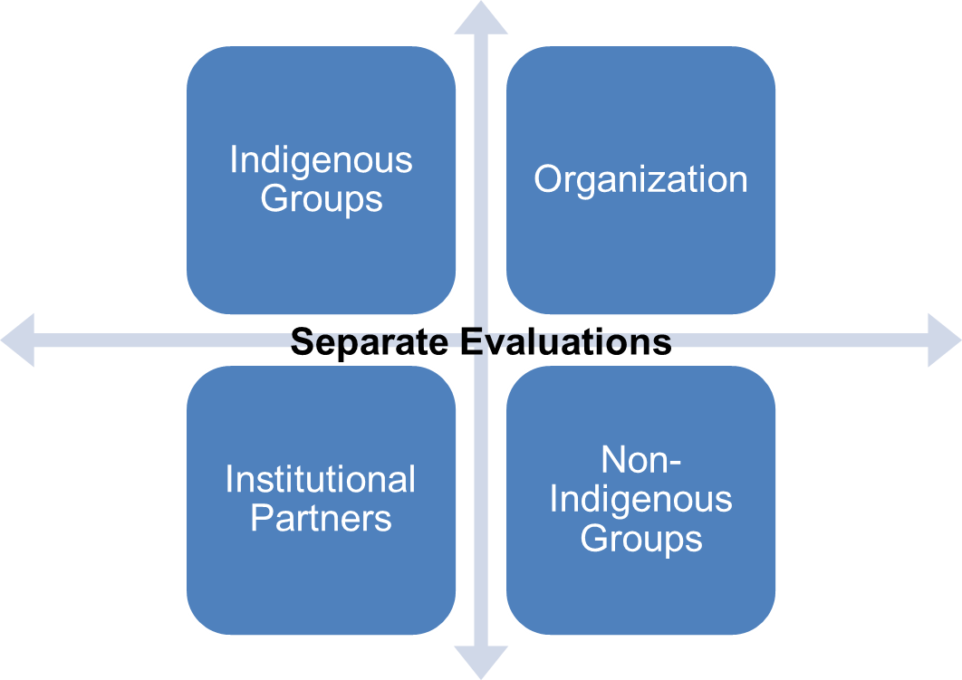
Lessons Learned
ISS: Thorough work before there are standard, vetted practices sets the stage for instances where those arrive late.
College Engagement: Consideration of best practices can drive quality improvement and move clients to the forefront of their field.
Complex environments may require the simultaneous consideration of several sets of standards in order to satisfy all key stakeholder groups.

Slide 39
Thank you!
idap@msu.edu
crismant@msu.edu
norman14@msu.edu
castrokr@msu.edu
@CommunityAIDMI
www.community-aid.org
Community-AID

